Slide 1
Programming for Non Programmers
Day 2

Slide 2
Agenda
Day 1
Overall Programming Concepts and Terms
Browser Specific Programming Concepts and Terms
HTML
CSS
Build a website!
Day 2
More Overall Programming Concepts and Terms
Server Specific Programming Concepts and Terms
JS
Databases
Build a web app!

Slide 3
Recap
Programming 101
Servers Vs Browsers
Process of Writing Code
HTML
CSS
Build a Website

Slide 4

Programming 101
Programs are ordered sets of Instructions to accomplish a task
Open toy chest
Pick up toys
Put toys in toy chest
Open hamper
Pick up clothes
Put clothes in hamper
And so on…
Pick up toys
Put toys in toy chest
Pick up clothes
Put clothes in hamper
Make bed

Slide 5
Servers Vs Browsers
Static Files
Server Code
Database
JavaScript
HTML
CSS
Web Server
User’s Machine

Slide 6
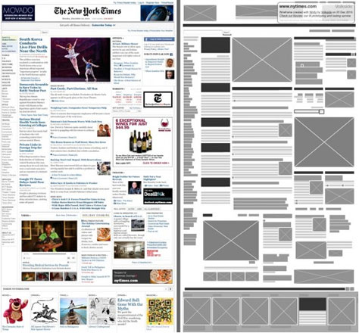
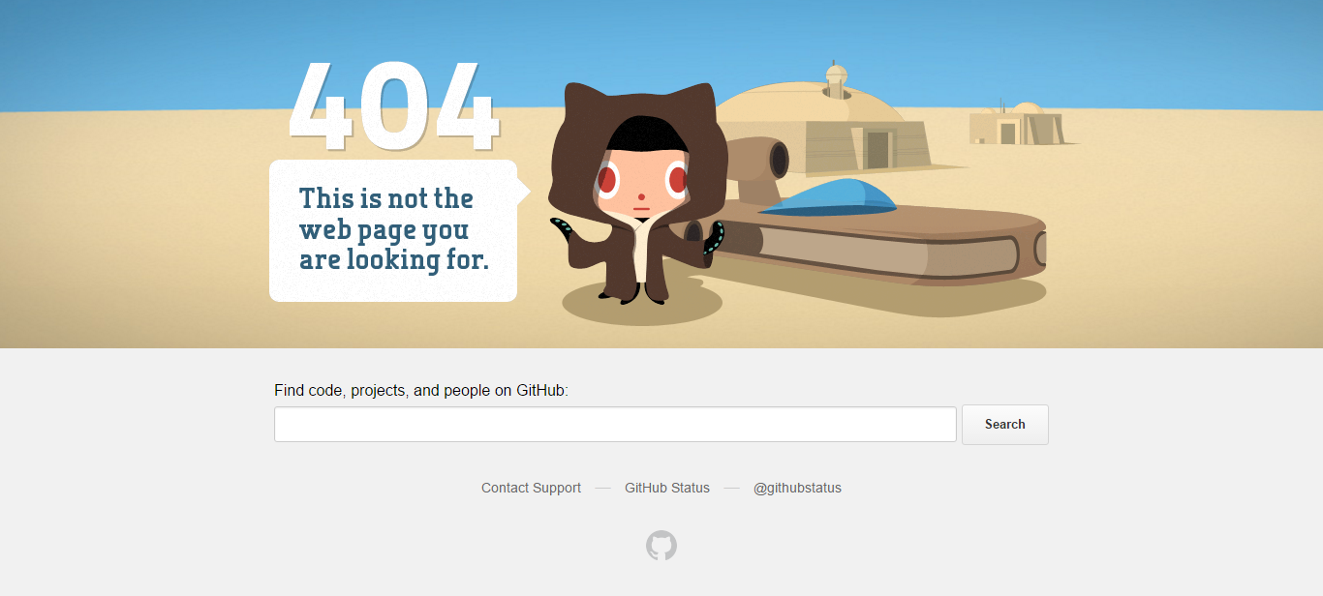
Process of Writing Code
Notes:
Start out being given a wireframe or design of what you need to create
Will have a spec documenting the required features and functionality of the thing to create

Slide 7
HTML
<html>
<head>
<title>This is my very first website!</title>
</head>
<body>
<h1 id=“page-heading”>Hello World!</h1>
<img class=“a-border” src=“folder/names/sleeping_baby.jpg”/>
<a href=“https://google.com” >Click Me To Go To Google</a>
<body>
</html>

Slide 8
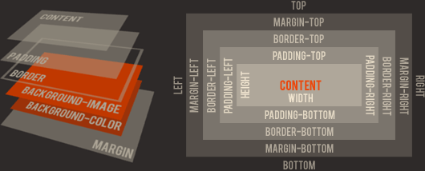
CSS
Box Model

Slide 9
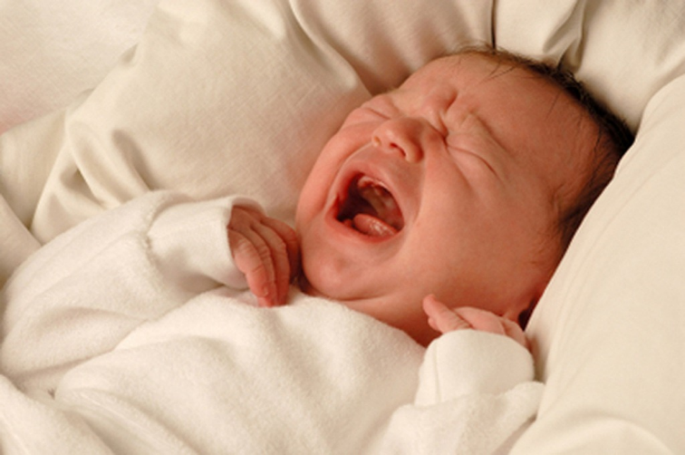

Recap
?

Slide 10
Day 2 Agenda
Programming 102
JavaScript & jQuery
Databases
Node.js
Resources
Build a Web App!

Slide 11
Programming 102
Functions
Classes
Basic Data Types
Inheritance
Variables
Conditionals
Arrays
Loops
Request Types

Slide 12
Programming 102
Functions
Unit of work
Individually responsible for as little action as possible
Optionally Accept Data as Arguments, return Data as a Result
Functional vs Procedural
Notes:
Functional
Focus on what information is desired and what transformations are required.
Act purely on what information is given to the function
Extremely useful in certain scenarios
Procedural
Focus on how to perform tasks (algorithms) and how to track changes in state.
Act based on the overall state of the application or information passed
More common

Slide 13
Programming 102
Classes
Representation of Something or Grouping of Related Actions / Functionality
Will Contain Multiple Other Classes
Standard Types (Primitive)
Developer Created
Notes:
Contain other classes – reinforce instructions -> instructions -> instructions
Standard Types are listed out soon!
Example class soon!

Slide 14
Programming 102
Basic Data Types
Character (character, char)
Integer (integer, int, short, long, byte)
Floating-point number (float, double, real, double precision)
Fixed-point number (fixed)
Boolean
Reference
Custom Classes
Notes:
Standard types:
Character (character, char)
Integer (integer, int, short, long, byte) with a variety of precisions;
Floating-point number (float, double, real, double precision);
Fixed-point number (fixed) with a variety of precisions and a programmer-selected scale.
Boolean, logical values true and false.
Reference (also called a pointer or handle), a small value referring to another object's address in memory, possibly a much larger one.
First example of things directly related to bits / bytes / memory storage, hint of how the code we right will truly have an effect on memory consumption

Slide 15
Programming 102
Components Of A Class
Constructor
Properties
Functions
Destructor

Slide 16
Programming 102
public class Table {
Table(width, length, legs) { Width = width; Length = length; Legs = legs; }
~Table() { foreach (Leg leg in Legs) { leg.CleanUp(); } }
int Width { get; set; }
int Length { get; set; }
List<Leg> Legs { get; set; }
int GetSurfaceArea() { return Width * Height; }
}
public class Leg {
Leg(width, length, height) { Width = width; Length = length; Height = height; }
int Width { get; set; }
int Length { get; set; }
int Height { get; set; }
void CleanUp() {}
}

Slide 17
Programming 102
Inheritance
_____ IS A ______
vs
_____ HAS A ______
Table IS A Leg
Table HAS A Leg
Table IS A Rectangle
Leg IS A Table
Leg HAS A Table
Leg IS A Rectangle

Slide 18
Programming 102
public class Rectangle {
Rectangle(int width, int length) { Width = width; Length = length; }
int Width { get; set; }
int Length { get; set; }
}
public class Table : Rectangle {
Table(int width, int length, List<Leg> legs) : base(width, length) { Legs = legs; }
List<Leg> Legs { get; set; }
}
public class Leg : Rectangle {
Leg(int width, int length, int height) : base(width, length) { Height = height; }
int Height { get; set; }
}

Slide 19
Programming 102
Concrete Classes
Can create an Instance of
Has all logic and properties needed to function on it’s own
Abstract Classes
Cannot create an Instance of
Provides some base level of properties or functionality
Expects another class to be derived from it and implement the rest

Slide 20
Programming 102
public abstract class {
Rectangle(int width, int length) { Width = width; Length = length; }
int Width { get; set; }
int Length { get; set; }
}
public class Table : Rectangle {
Table(int width, int length, List<Leg> legs) : base(width, length) { Legs = legs; }
List<Leg> Legs { get; set; }
}
public class Leg : Rectangle {
Leg(int width, int length, int height) : base(width, length) { Height = height; }
int Height { get; set; }
}

Slide 21
Programming 102
Encapsulation
Accessibility of Classes and Properties
Public
Protected
Private

Slide 22
Programming 102
public class Car {
private int EngineMileageCount { get; set; }
public int GetMileageCount() { return EngineMileageCount; }
public bool StartDriving(int milesPerSecond) { // This will update EngineMileageCount every second }
public bool StopDriving() { // Stops updating which was stared above }
protected void ResetMileageCount() { EngineMileageCount = 0; }
}
public class CarWithReplaceableEngine : Car {
public void ReplaceEngine() { ResetMileageCount(); }
}

Slide 23
Programming 102
Interfaces
Contract between implementation and consumer
Says I do “xyz”, but you shouldn’t care how “xyz” is done
Consumer can be ignorant of how the interface is implemented
public interface IEngine {
public bool StartEngine();
public bool StopEngine();
public bool UpdateSpeed(int newSpeed);
}

Slide 24
Programming 102
Dependency Injection
Live and Die by Interfaces
Class’s constructor takes in as many interfaces as needed to accomplish it’s work
Creator of class is responsible for creating instance of concrete implementation and providing it to that new instance of the class
Class utilizing the interface is no longer needs to create the things it needs
Inversion of Control

Slide 25
Programming 102
public class Car {
public Car(IEngine engine) { Engine = engine; }
private IEngine _engine { get; set; }
public StartCar() { _engine.StartEngine(); }
}
public interface IEngine {
public bool StartEngine();
public bool StopEngine();
public bool UpdateSpeed(int newSpeed);
}
Notes:
Makes Testing much easier

Slide 26
Programming 102
Classes Tips
One class is the representation of ONE thing or responsible for ONE thing
Strive for the simplest representation possible
Build as many additional classes as needed
Default to private and only expose what you need to

Slide 27
Programming 102
Variables
Named Local Representation of Something and it’s State
Do Actions On
Pass into and out of Functions
Have a “Scope”
name = “Mike”
situps = 97 + 1 + 1 + 1 + 1

Slide 28
Programming 102
Conditionals
If this, then do that
Can be chained together
Can be nested inside of each other
If key fits in lock
Then unlock door
height = 60
if(height > 65) {
print “Enjoy the ride!” } else {
print “Must be at least 65 inches to ride this ride!”
}

Slide 29
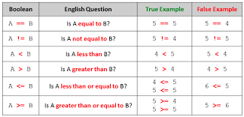
Programming 102
Comparison Operators

Slide 30
Programming 102
Switch
Execute this piece of code when this variable is this value
Switch on cars
If Jeep, drive off road
If Tesla, check charge
If none of the above, go for test drive
state = “Colorado”
switch(state) {
case “Colorado”:
goSkiing();
break;
case “New York”:
goToStatueOfLiberty();
case “California”:
goToBeach()
break;
default:
googleThingsToDoInState(state);
break;
}

Slide 31
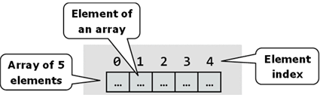
Programming 102
Arrays
List of things

Slide 32
Programming 102
Loops
Repeating things in order
Can be nested (be careful here!)
for(int i = 0; i < 10; i++) { work goes here }
foreach(variableName in array) { work goes here }
while(i < 10) { work goes here }
do { work goes here } while (i < 10)

Slide 33
Programming 102
Loops
Break
Continue
Goto
Notes:
Break -> exit loop
Continue -> skip rest of this iteration of the loop and start on next one
Goto -> only in older languages, means go to this specific step or statement

Slide 34
Programming 102
Weird But Common Things
Off by one errors
NULL
undefined (JavaScript specific)
Stack Overflows
Notes:
Off by one are super common. Mostly occur because arrays start at index 0, but counts / lengths start at 1
Stack Overflow is when the computer has entered a loop that just keeps adding function calls until it runs out of memory and crashes

Slide 35
Programming 102
Request Types
Get / Post / Put / Delete
Synchronous Vs Asynchronous
Response Codes
RESTful APIs
http://api.example.com/resources/
http://api.example.com/resources/item17
Notes:
REST = Representational state transfer
Collection, such as http://api.example.com/resources/
GET: List the URIs and perhaps other details of the collection's members.
PUT: Replace the entire collection with another collection.
POST: Create a new entry in the collection. The new entry's URI is assigned automatically and is usually returned by the operation.[16]
DELETE: Delete the entire collection.
Element, such as http://api.example.com/resources/item17
GET: Retrieve a representation of the addressed member of the collection, expressed in an appropriate Internet media type.
PUT: Replace the addressed member of the collection, or if it does not exist, create it.
POST: Not generally used. Treat the addressed member as a collection in its own right and create a new entry in it.[16]
DELETE: Delete the addressed member of the collection.

Slide 36
Programming 102
?

Slide 37
JavaScript & jQuery
Our First Programming Language!
Technically called ECMAScript
Multiple Versions
Released in 1996 for Netscape Navigator
ES5 (most common)
ES6 (some support)
ES7 (need transpilier)
Notes:
ES6 finalized
ES7 not finalized so it changes but there are some things out there using some features

Slide 38
JavaScript & jQuery
<script type="text/javascript“ src=“url/to/js/file.js"></script>
function functionName(param1, param2) {
// this is a comment, but work would go here
return someVariableNameOrValue;
};
var variableName = value;
var variableName2 = {};
console.log(‘this gets printed to the console’, thisObjectIsNicelyPrinted);
Notes:
Semi-colons are bountiful

Slide 39
JavaScript & jQuery
function outerFunction(param1, param2) {
var outerVar = 1;
function innerFunction(param3, param4) {
var innerVar = 2;
globalVar = “This is Bad. Don’t Do This.”;
return innerVar + 5;
}
var bottomVar = 3;
var funcResult = innerFunction(1,2);
};
Notes:
Params
Hoisting

Slide 40
JavaScript & jQuery
var object = {
propertyName: propertyValue,
propertyName2: propertyValue2,
propertyName3: propertyValue3
};
object.propertyName2; // returns propertyValue2
object[‘propertyName2’]; // alternative way of accessing property
object.propertyName3 = 5; // sets propertyName3 to be 5
object[‘propertyName3’] = 5; // alternative way of setting property

Slide 41
JavaScript & jQuery
Callbacks
function runMeFirst(callback) {
// I’m doing work here
if(callback !== undefined) return callback();
else return 1;
};
function runMeSecond(callback) {
// I’m doing work here
if(callback !== undefined) return callback();
else return 0;
}
var result = runMeFirst(runMeSecond);
Notes:
Try not to use these, use a thing called Promises that we’re not going to talk about (unless extra time)
http://andyshora.com/promises-angularjs-explained-as-cartoon.html

Slide 42
JavaScript & jQuery
jQuery
Library to provide functionality and access to User Interface
$
$(‘selector’)
$(document).ready(function() {
//work goes here
});

Slide 43
JavaScript & jQuery
Altering Existing DOM Objects
addClass()
removeClass()
css()
attr()
data()
$('#result').addClass('green');
$('#result').removeClass('green');
$('#result').css(‘color’,’green');
$('#result').attr(‘href’,’new url val');
$('#result').data(‘init-val’, ‘5’);

Slide 44
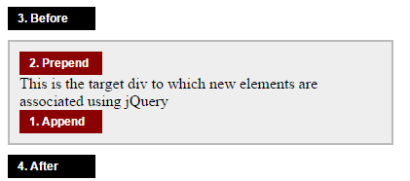
JavaScript & jQuery
Altering DOM Objects
remove() vs detach()
hide() vs show()
Notes:
myOrder.append(burger)
burger.appendTo(myOrder)
Remove destroys, detach keeps it around

Slide 45
JavaScript & jQuery
Event Options
on() & off()
change()
click()
keypress() & keyup()
mousedown() & mouseup()
mouseenter() & mouseleave() & mousemove()

Slide 46
JavaScript & jQuery
Event Options
$('#thisIsMyId').click(function() {
// Code to run on click goes here
});
$('#thisIsMyId').on(‘click’, function() {
// Code to run on click goes here
});
$('#thisIsMyId').off(‘click’);

Slide 47
JavaScript & jQuery
Dealing With Inputs
val()
text()
$(‘#inputID’).val();
$(‘#inputID’).val(‘new value’);
$(‘#someID’).text();
$(‘#someID’).text(‘new value’);

Slide 48
JavaScript & jQuery
Dealing With Inputs
ajax()
$.ajax({
type: "POST",
url: urlString,
data: dataObj,
success: successFunc,
error: errorFunc
});

Slide 49
JavaScript & jQuery
jQuery
filter() - $( “selector" ).filter(function( index ) { return index % 3 === 2; })
.css( "background-color", "red" );
find() - $( “ol" ).find( "li.makeMeRed" ).css( "background-color", "red" );
Notes:
Filter returns all things that match condition
Find will get all children of element that match selector passed to it

Slide 50
JavaScript & jQuery
jQuery
each() - $( "li" ).each(function( index ) { console.log(index); });
map() - $( ":checkbox" ).map(function() { return this.id; }).get().join();
Notes:
Each does an action on every element that will match the selector, most jQuery things work this way by default
Map runs a function on each thing that matches in order to change the matching object into something else. This will return a comma separated list of the ids

Slide 51
JavaScript & jQuery
jQuery
first() - $( "li" ).first().css( "background-color", "red" );
last() - $( "li" ).last().css( "background-color", "red" );
Notes:
First and last do what you’d expect

Slide 52
JavaScript & jQuery
?

Slide 53
JavaScript & jQuery
Let’s Build A Calculator
Have 2 Inputs
Have a Dropdown for Operation
Have a Result Display
Have Result be Green when > 100 and Red when < 0
http://bit.do/mikePFNP

Slide 54
Setting Up Your Dev Environment Pt 2a
Install Node.js - https://nodejs.org/
Install MySQL - http://dev.mysql.com/downloads/mysql/

Slide 55
Databases
Organized collection of data
Source of all user entered or automatically collected data
Relational vs non
Table vs Web
Common Types: mySQL, Oracle, MongoDB
Notes:
SQL (Structured Query Language)

Slide 56
Databases
CRUD
Create
Read
Update
Destroy
Also can be SCRUD (Searching)

Slide 57
Databases
Queries
Ask the DB for information
In Memory Vs In Database
Multiple Ways to Find Every Result Set
Never Trust User Input!
“Johnny Drop Tables”
Notes:
https://xkcd.com/327/

Slide 58
Databases
Columns
Declared to be a single type from set of options
Options differ between database types
Other things settable
Uniqueness
Allow Nulls
Auto-Incrementing
Generate Value
Notes:
CHAR, VARCHAR, INT, BOOL, DECIMAL, FLOAT, DATETIME, BLOB

Slide 59
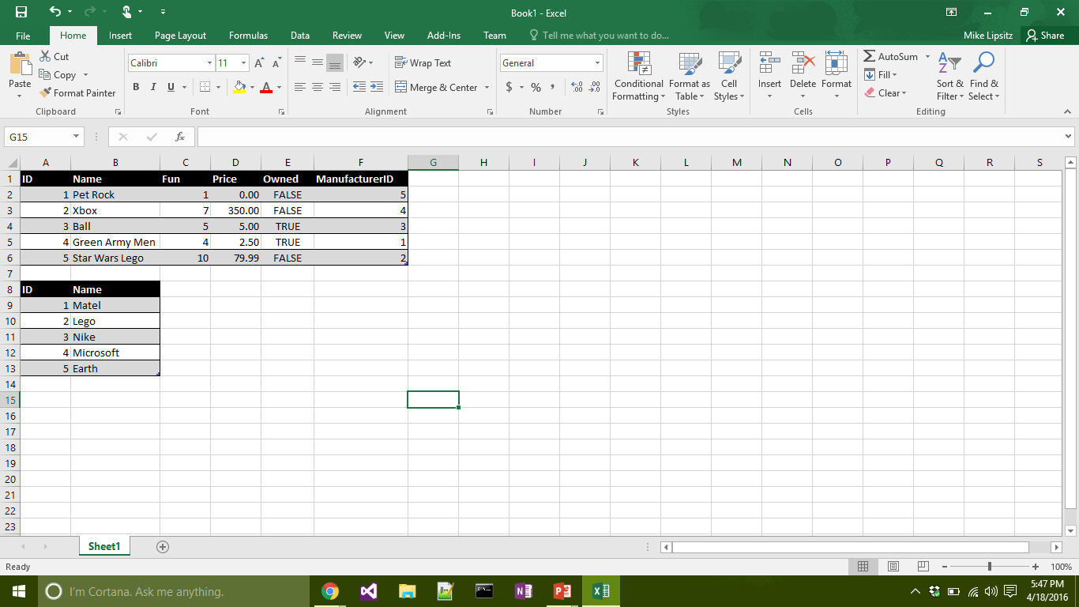
Databases
Create
INSERT INTO Toys (Name, Fun, Price, Owned)
VALUES (‘Pet Rock’, 1, 0, 0), (‘Xbox’, 7, 350, 0)

Slide 60
Databases
Read
SELECT * FROM Toys WHERE Price < 10 AND Fun > 7 AND Owned = 0

Slide 61
Databases
Update
UPDATE Toy SET Price = 2.50 WHERE ID = 4

Slide 62
Databases
Destroy
DELETE FROM Toy WHERE ID = 6

Slide 63
Databases
Keys
Primary
Foreign

Slide 64
Databases
Indexes
Data will be stored in order according to chosen indexes
Querying based on indexes is fastest possible

Slide 65
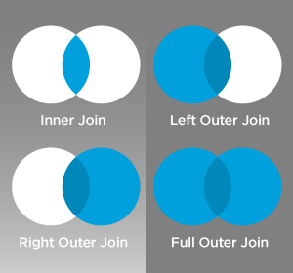
Databases
Joins

Slide 66
Databases
Transactions
Group together set of Queries
Only Commits changes if all succeed
Enables easier error handling

Slide 67
Databases
?

Slide 68
Setting Up Your Dev Environment Pt 2b
Create Database in MySQL
Name: calculator
Create Table
Name: entries
Columns: ID (int, PK, NN, UQ, AI), Value1 (float), Value2 (float),
Operand (varchar(1)), Result (float)
Install NPM packages - Use http://bit.do/mikePFNP and do “npm install” in project folder or:
“npm install express --save” in project folder
“npm install mysql --save” in project folder
“npm install cors --save“ in project folder
“npm install body-parser --save“ in project folder

Slide 69
Node.js
Package.json
{
"name": “my-first-node-app",
"main": “app.js",
"dependencies": {
"body-parser": "^1.15.0",
"cors": "^2.7.1",
"express": "~4.0.0",
“mysql”: “~2.10.2”
}
“dev-dependencies”: {
“karma”: “~2.00”
}
}

Slide 70
Node.js
var express = require('express');
var app = express();
var router = app.Router(); // get an instance of the express Router
router.get('/', function(req, res) {
res.json({ message: ‘Hooray! Welcome to our server!' });
});
router.post('/', function(req, res) {
res.json({ message: ‘Hooray! Welcome to our server!' });
});
var port = process.env.PORT || 8080;
app.listen(port);
console.log('Magic happens on port ' + port);

Slide 71
Node.js
Running The App
node app.js

Slide 72
Node.js
var mysql = require("mysql");
var con = mysql.createConnection({
host: "localhost",
user: “mike",
password: “mikePassword",
database: “calculator"
});

Slide 73
Node.js
con.connect(function(err){
if(err){
console.log('Error connecting to Db');
return;
}
console.log('Connection established');
});
con.end(function(err) {
// The connection is terminated gracefully
// Ensures all previously enqueued queries are still
// before sending a COM_QUIT packet to the MySQL server.
});

Slide 74
Node.js
con.query('SELECT * FROM entries',function(err,rows){
if(err) throw err;
console.log('Data received from Db:\n');
console.log(rows);
});

Slide 75
Node.js
var newEntry = {
value1: 10,
value2: 2.5,
operation: ‘*’,
result: 25
};
con.query('INSERT INTO entries SET ?', newEntry, function(err,res){
if(err) throw err;
console.log('Last insert ID:', res.insertId);
});

Slide 76
Node.js
?

Slide 77
Databases & Node.js
Let’s Update Our Calculator!
Store the values that were entered
Store the operation selected
Store the result
Help With Node Requests
https://scotch.io/tutorials/build-a-restful-api-using-node-and-express-4
http://bit.do/mikePFNP

Slide 78
Resources
Help! I’m Stuck!
Google!
Stack Overflow
css-tricks
mdn
API documentation
caniuse.com

Slide 79
Resources
Inspiration
Dribble
Product Hunt
Hacker News

Slide 80
Resources
Further Learning
Online Vs Bootcamp Vs Immersive
Treehouse
CodeAcademy
Scotch.io
GA

Slide 81
Build Your Own Web App
Let Your Creativity Guide You
Or build a To-do application
Ask Questions If (When) You Get Stuck
But I may just direct you to Google or give you a hint

Slide 82
Recap
Programming 102
JavaScript & jQuery
Databases
Node.js
Resources
Build a Web App!

Slide 83
Programming 102
Functions
Custom Classes
Basic Data Types
Variables
Conditionals
Arrays
Loops
Request Types

Slide 84
JavaScript & jQuery
function outerFunction(param1, param2) {
var outerVar = 1;
function innerFunction(param3, param4) {
var innerVar = 2;
globalVar = “This is Bad. Don’t Do This.”;
}
var bottomVar = 3;
};

Slide 85
Databases
CRUD
Create
Read
Update
Destroy
Also can be SCRUD (Searching)

Slide 86
Node.js
var express = require('express');
var app = express();
var router = app.Router(); // get an instance of the express Router
router.get('/', function(req, res) {
res.json({ message: ‘Hooray! Welcome to our server!' });
});
var port = process.env.PORT || 8080;
app.listen(port);
console.log('Magic happens on port ' + port);

Slide 87
Recap
?

Slide 88
Recap
Thanks for coming!
Questions?
mike@zippyinnovations.com

